Slide 1

TETRIS
Submitted in the partial fulfillment for the award of
the degree of
BACHELOR OF ENGINEERING
IN
Computer Science Engineering
Submitted by :
Tushar Dhiman
17BCS4161
Rishabh Bajpai
17BCS4143
Under the Supervision of:
Mrs. Akwinder
Department of AIT-CSE
DISCOVER . LEARN . EMPOWER

Slide 2
Outline
Introduction to Project
Problem Formulation
Objectives of the work
Methodology used
Results and Outputs
Future Scope
References

Slide 3
Introduction to Project
The games industry has had much growth in recent years. It is a great industry to
get involved in as it allows creativity, innovation and freedom for developers and
hobbyists. They get a chance to experiment with all forms of media including
sound design, environment design and programming. So we are working on a game called “TETRIS” . The purpose of this project was to build a Tetris video game system using System Verilog and Python language on a FPGA board. Our Tetris game is a single player game where the computer randomly generates tetromino blocks (in the shapes of O, J, L, Z, S, I) that the user can rotate using their game controller.

Slide 4
To develop this game we required some specific softwares: Knowledge of Python Visual Studio Unreal engine Epic game launcher Windows platform Python will be used in backend

Slide 5
Problem Formulation
This project is being created in order to decrease stress of people during this times of calamity.
It is more useful in corona time.
During software development, clones can occur in software intentionally or unintentionally.
Developers tend to clone fragments of software during development to save efforts and expedite the development process.

Slide 6
Objectives
to develop creativity and individuality in problem solving and performing tasks. to prepare students to work in teams. to prepare students to improve their skills and knowledge related to specific job positions individually. to enable students to do self-study.
to prepare students to improve their skills and knowledge
related to specific job positions individually
to enable students to develop games individually and in teams
How to Win Games and Influence People. Victory Objectives are the most basic and fundamental goals of the game. They're what the player is ultimately trying to achieve—what they need to do to win

Slide 7
Methodology used
Knowledge of Python
Visual studio
Unreal engine
Epic game launcher
Windows platform
From this smart game, user can relief the stress and play easily and enjoy. They provide the new maps and free skins.

Slide 8
Results and Outputs

Slide 9
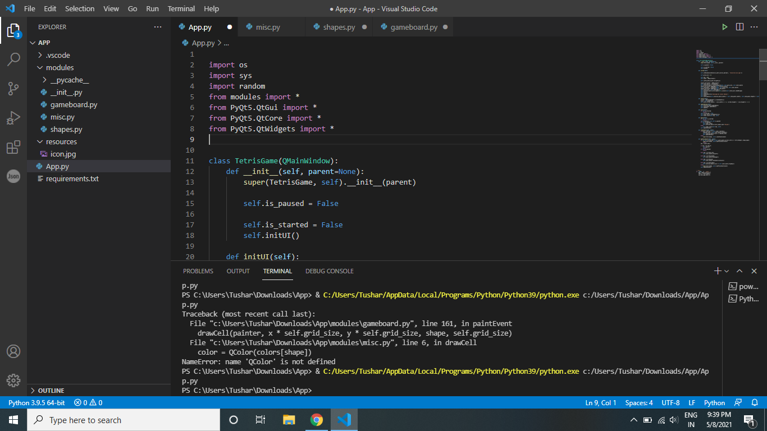

Slide 10
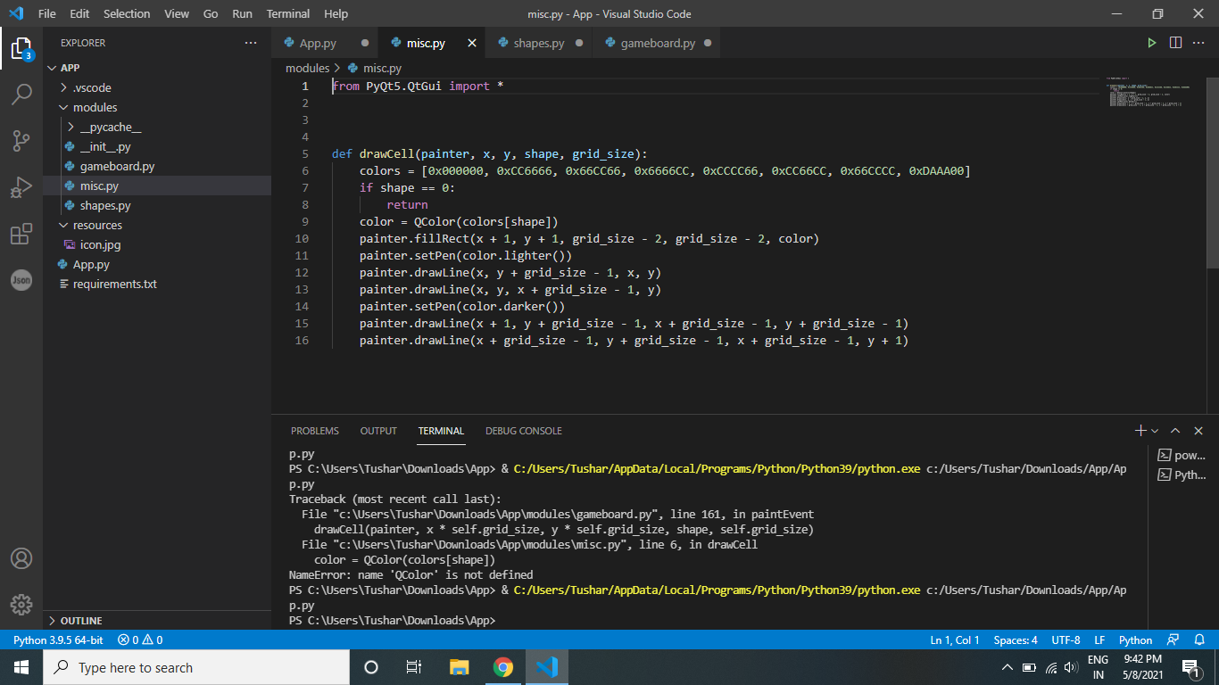

Slide 11
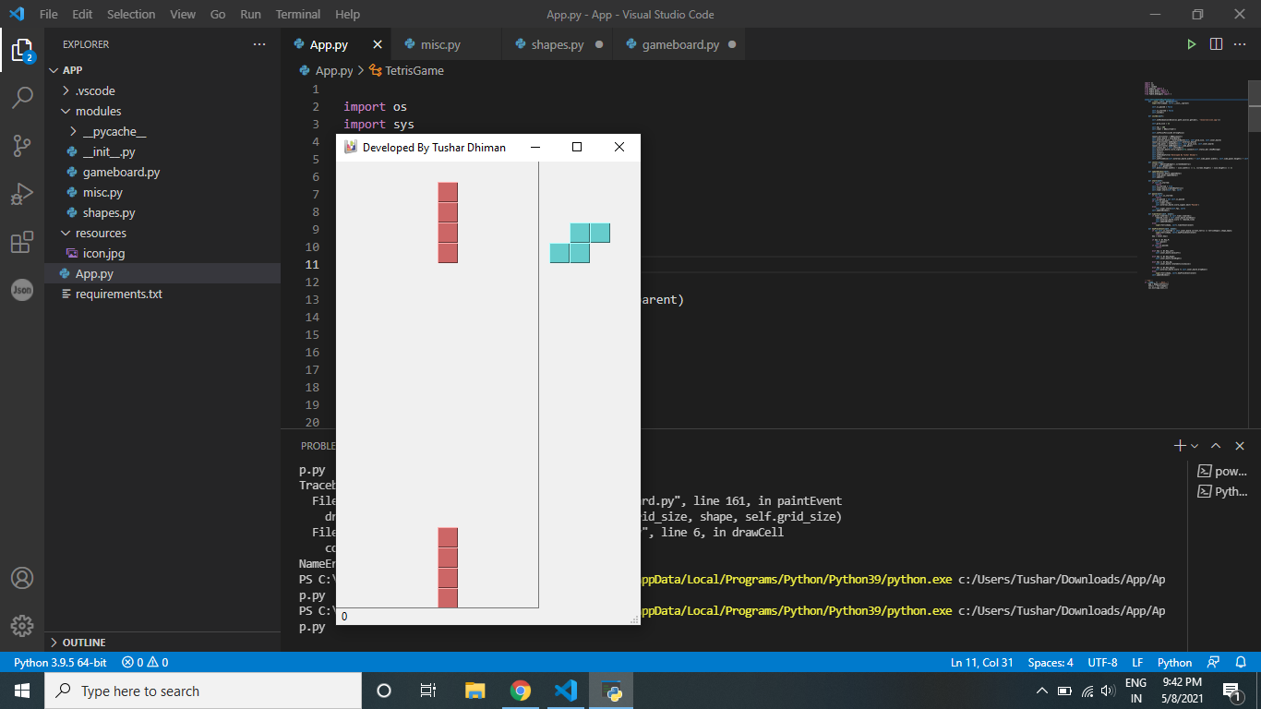

Slide 12
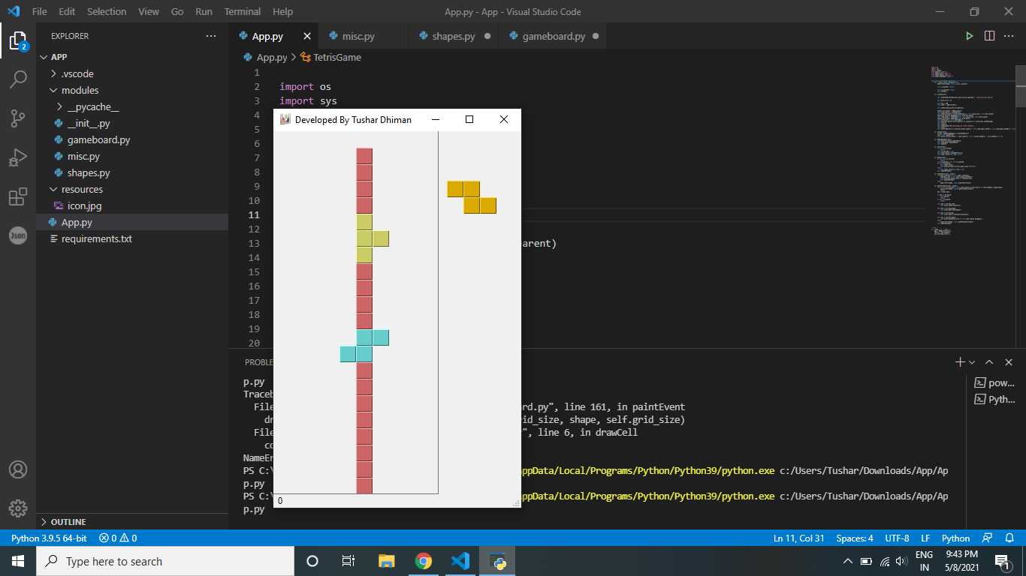

Slide 13
Future Scope
More entertaining and more graphics can be added in future. It is forecasted that the gaming industry will generate great opportunities for game developers over the next two years. The gaming industry has grown its presence over various platforms – mobile, console, PC, online gaming and the industry is growing really fast along with the presence on all these platforms.

Slide 14
References
C. Anderson (2007). The Innovation in Gaming Isn't on the Screen. R.T. Beckwith, L. Brandt, B.M. Slator (2006). Electric Worlds in the Classroom:
Teaching And Learning With Role-Based Computer Games. Teachers College
Press. 182 p. D.A. Bowman, C. North, J. Chen, N.F. Polys, P.S. Pyla, and U. Yilmaz
(2003). Information-Rich Virtual Environments: Theory, Tools, and Research
Agenda. Proceedings of the ACM symposium on Virtual reality software and
technology, Osaka, Japan, 2003.
J. S. Brown, A. Collins and P. Duguid 1989. Situated Cognition and the Culture
From their website: "Game Research attempts to bring together knowledge on
computer games from the areas of art, business, and science. Traditionally
such cross-communication has been sparse to the detriment of all involved."

Slide 15
Thank You

